Slide 1
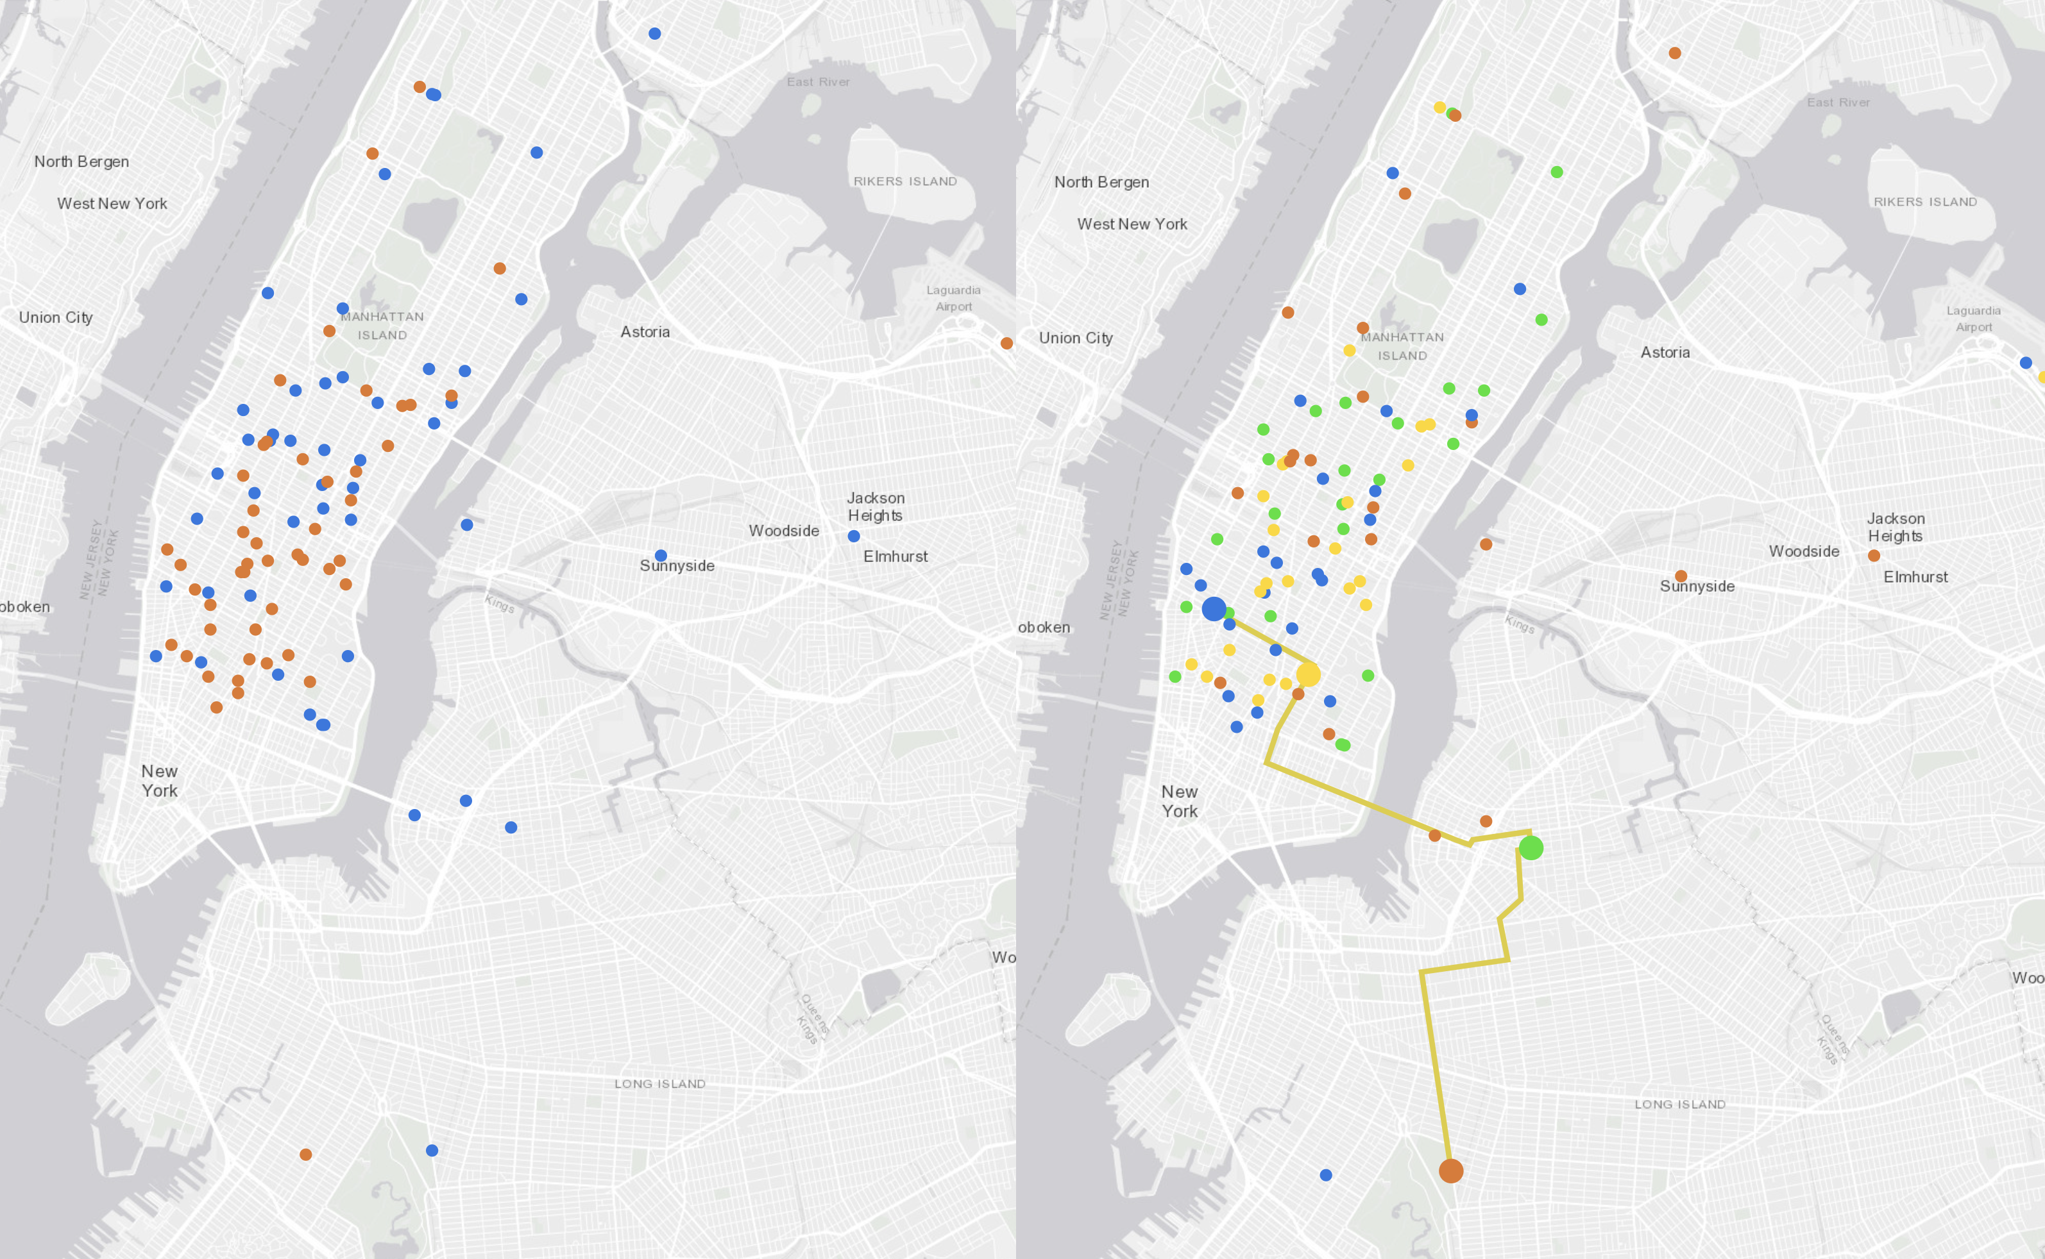
Team Newbie
Evan Yang, ZhuFu Lu, JunFeng Li and James Adams

Slide 2
Simple Ride Sharing
Motivations
Research has shown that up to 95% of New York taxi trips could be shared_{[1]}.
Detailed graph based model minimizing increased cost.
Reduced travel cost for customers
Reduces pollution and congestion
Increased profitability for drivers as less time spent idle between journeys.
Goals
Develop simple algorithm to identify shareable rides
Create an algorithm that creates shared rides based on the two trip sharing case from Santi’s “Quantifying the benefits of vehicle pooling with share ability networks”
Visualize the shared rides in browser to allow fast analysis of algorithm effectiveness

Slide 3
Data Cleaning
Remove taxi journeys where the car is full (Passengers > 3)
Remove data not relevant to ride sharing
E.g. Medallion Number, Hack License
Remove jobs with latitudes/longitudes outside of NY bounding box
Use of anomalous/invalid locations (such as data points in the ocean) was avoided due to rejecting one sized clusters, as well as the requirement for small distances between shared ride pickup and drop-off locations.

Slide 4
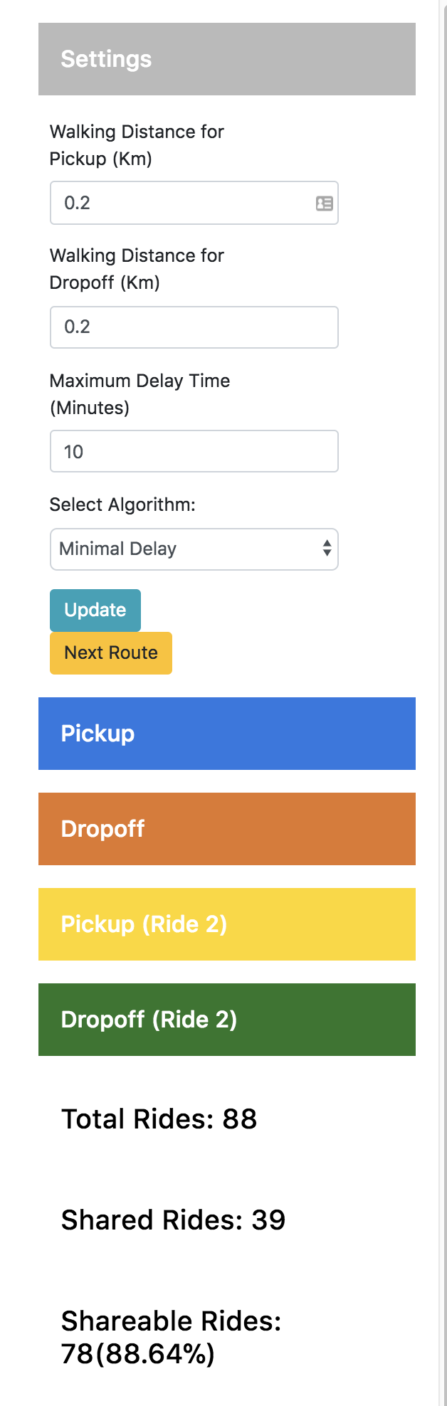
Simple HTTP API for Algorithm Constraints
Allows modification of parameters for rapid visualization
Maximum walking distance to pickup and drop-off
Maximum delay for drop off time.
Simple metrics of algorithm performance
More complex metrics would be useful here, such as average cost, journey length, etc.

Slide 5
Initial Naive Algorithm
Developed to test visualization
Groups rides that have tolerable pickup and drop-off times and locations
Creates a distance matrix between the pickup locations and drop-off locations for all rides.
Where two rides are acceptable in terms of distance between pickup and drop-off, ensure that they have similar drop-off times.
Collapse the sharable rides into single rides provided taxi has enough remaining seats

Slide 6
Assumptions
Taxis can accommodate at most four passengers
Taxi journeys with > 3 passengers are removed
Assume arrival time of journey is the time passengers wanted to arrive at destination
Pickup time is less important than arrival time, if journey times are similar and arrival time is maintained

Slide 7
Naive Algorithm - Results
Very low amount of shareable rides with ‘reasonable’ parameters.
10 minute delays, 200m walk to pickup/drop-off
Number of shareable rides out of total rides increases as walking distance to pickup and drop-off increases as expected

Slide 8
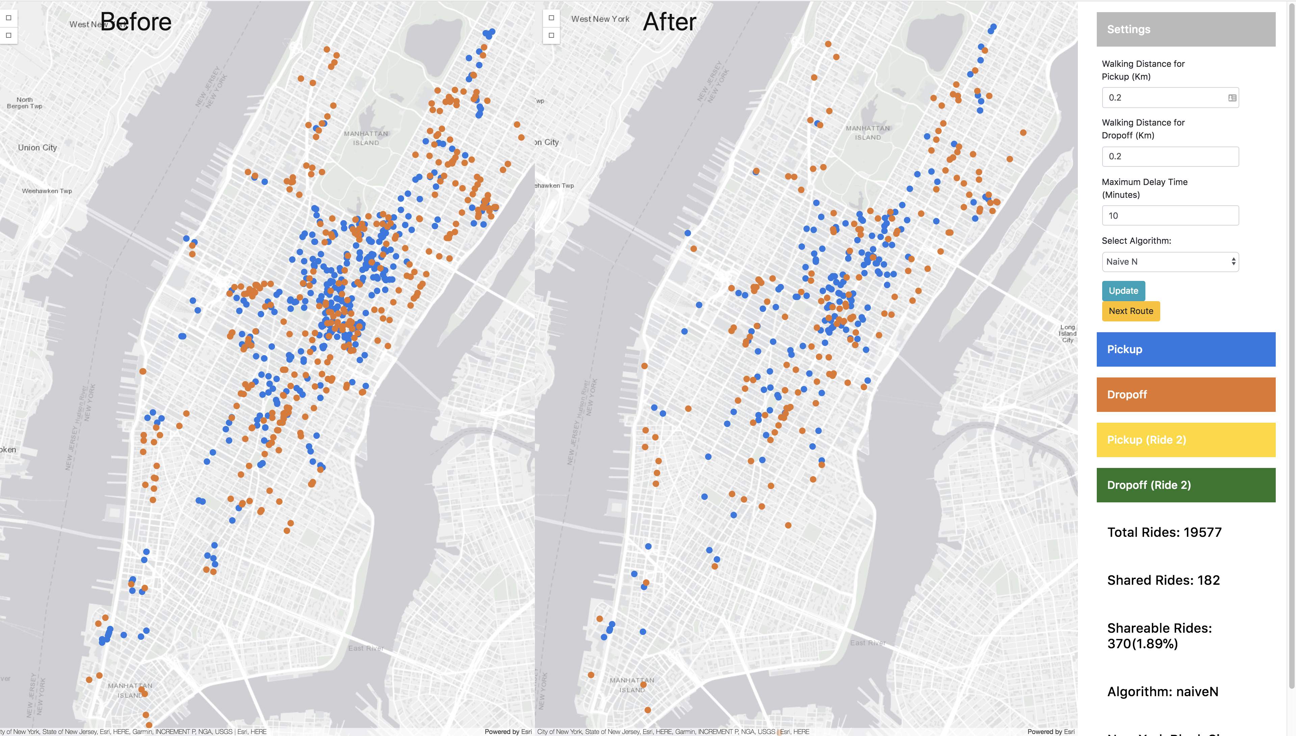

Slide 9
DBSCAN Cluster Algorithm
Why Cluster?
It’s easy for us to come up with the Cluster Algorithm when we need to match the location point by pair.
Why DBSCAN?
We are familied with K-means, but it needs to be provided with a set number of clusters. DBSCAN has some parameters which have direct relation with our data.
Data = DBSCAN(eps=epsilon, min_samples=a,algorithm= ,metric= )
Notes:
the epsilon is related to the distant that people are willing to walk for the sharing, and the min_samples (which means the least point for determine a cluster )also has something to do with the number of passenger in one taxi

Slide 10
DBSCAN Cluster Algorithm - Results
Result:
if people are willing to walk 200m , the sharedride/allride-ratio can be 40%.
Problem:
the distant. When we choose long walking distant, the algorithm may line up those cluster to one big cluster , which will produce so many sharing case that does not make sense.
Optimization:
the real walk distant. In the algorithm , we match these ride randomly . We may consider using some algorithm like DNN to make the real walk distant in all to be the least

Slide 11
Minimal Delay Algorithm
Bookings are paired off if a passenger can be picked up along the way, without compromising the drop off times of either ride.
Assumes a ride booking platform without prebookings
Easy to adapt to a ride sharing mobile application
Earliest booking in pair must complete first
Reduces complexity of distance matrix and number of routes which must be calculated
Bookings must complete within N minutes of their completion time in the data

Slide 12
OSRM – Routing Engine
Used for Minimal Delay algorithm
Long build time using open street map data for New York hence only finished compilation on Sunday
Open Street Map Data is free to download.
Most cities have individual exports for faster reading into OSRM (when compared to an entire countries road network)
Free, Open Source, Fast!
HTTP API + Python Bindings
Use this for high volume of requests instead of Google routing services unless you require real time congestion avoidance.
Also has a C library.

Slide 13
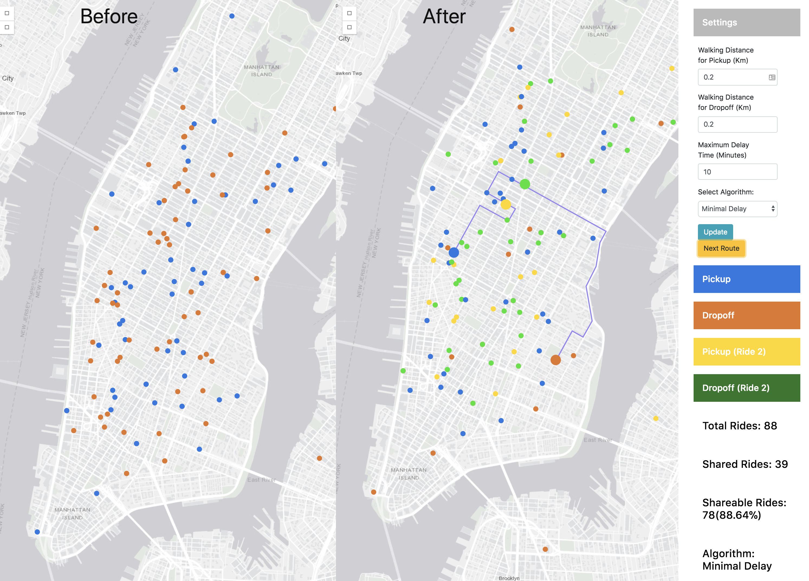
Minimal Delay Algorithm - Results
Here we can see the dynamic dispatch of a journey, with the route being changed to go through the second journeys pickup point (yellow)
This is a good route however some routes are still sub optimal
On data sets tested > 50% of rides are shared

Slide 14
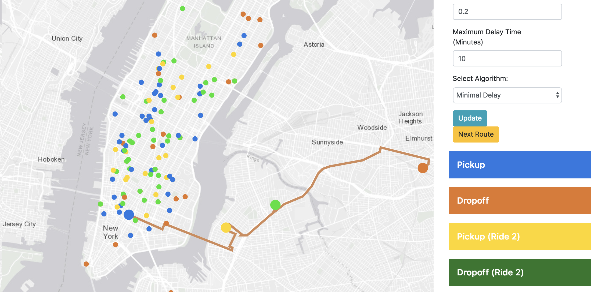

Slide 15
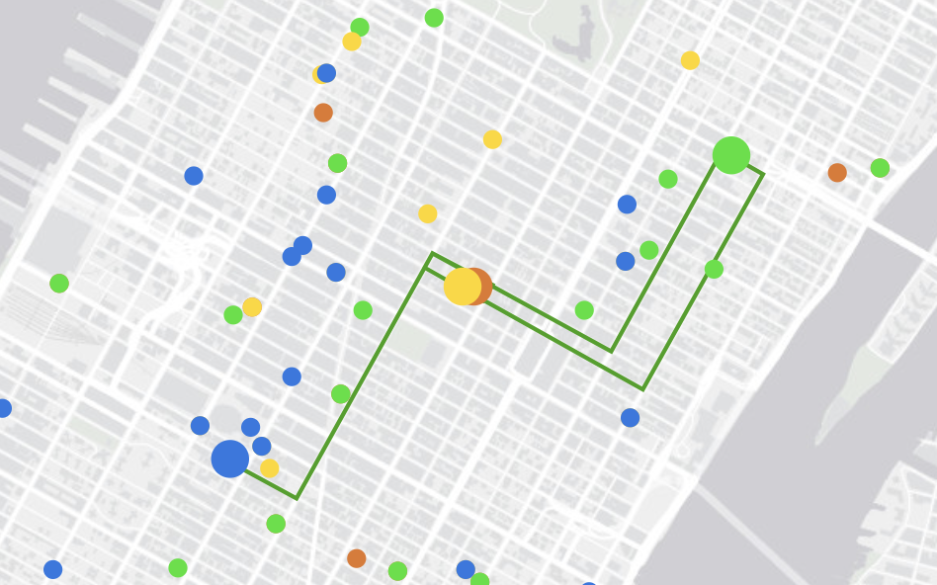
Minimal Delay Algorithm - Inefficiencies
Constraints are still satisfied but not optimally.
This a minimization and matching problem – order of consideration changes results.
Could go from yellow to orange and drop off but instead visits green (second journeys dropoff)

Slide 16
Technology Used
Python
With associated data handling libraries
Pandas, Numpy, geopy, DBSCAN, Flask
Bash command line tools
Sed, AWK, head, tail
ArcGIS JS + JQuery
Allows 2d and 3d geo-data visualization

Slide 17
Algorithm
Groups taxi trips into N minute intervals
Where N minutes is the maximum waiting time

Slide 18
Future Work – Shareable Ride Analysis
Determine if certain destinations have a high proportion of shareable rides.
The types of these destinations can be determined using the reverse geocode and Place API from Google
Represent algorithm using set notation
Compare performance of algorithms for different datasets
Cluster data before and after sharing to determine whether congestion is eased up
Similar centroids but reduced cluster size would show reduced congestion
Visualizer shows heavy reduction of congestion in popular areas.
Optimize for other metrics such as cost
Investigate human factors which determine shareable rides
Look for existing studies
Approach as a Graph Theory based problem

Slide 19
Conclusions
With a simple ride sharing heuristic, > 50% of rides can be shared
Improvements to the algorithm such as continual chaining of passenger pickups and sharing (as opposed to just pairing rides) could get us closer to seeing results closer to 95% of rides being shareable.

